Slide 1
Data Science
Teammates: Zhaoyang Pan, Sirui Zeng,
Xiaolong Zhu, Ruikang Yan

Slide 2
Project Introduction
Purpose:
Explore the eligibility for Clean Alternative Fuel Vehicles (CAFV).
Find out possible factors that influence a vehicle's eligibility, such as range, vehicle year, make, and type.
Impacts:
Help optimize electric vehicle eligibility standards
More electric vehicles help reduce carbon emissions
Help automakers optimize electric vehicle design
Help consumers understand environmental protection
Introduction

Slide 3
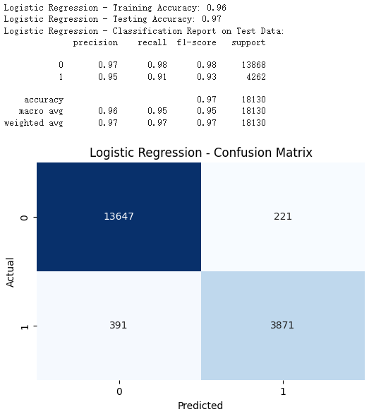
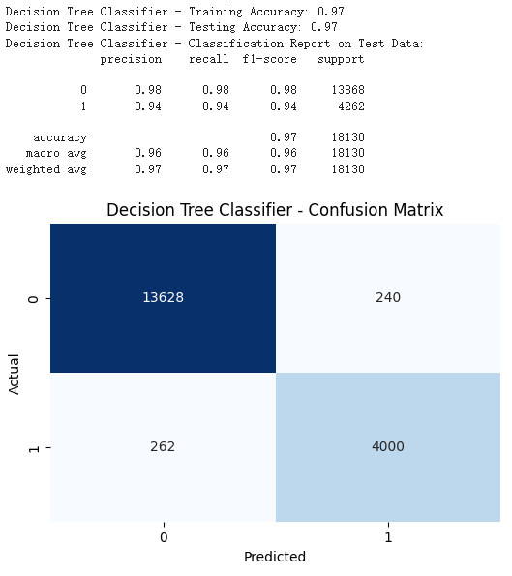
What Did We Find?

Slide 4
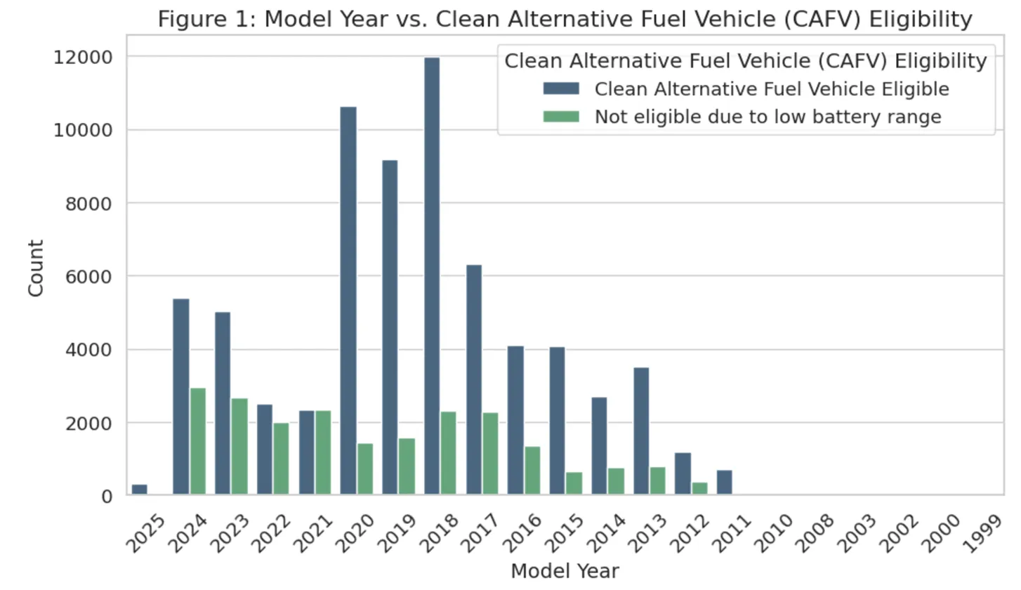
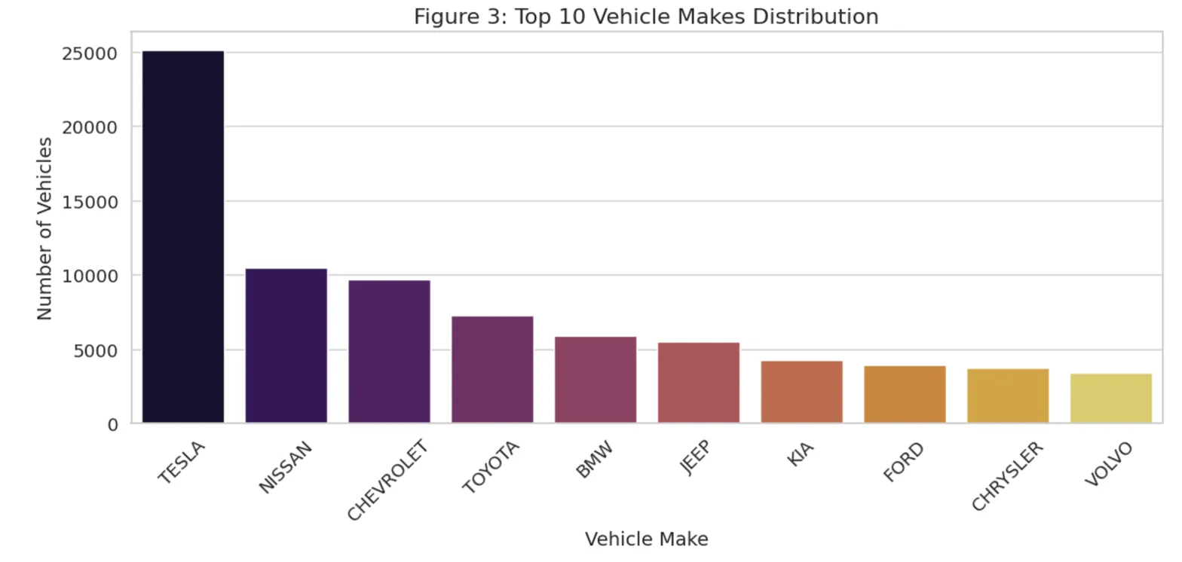
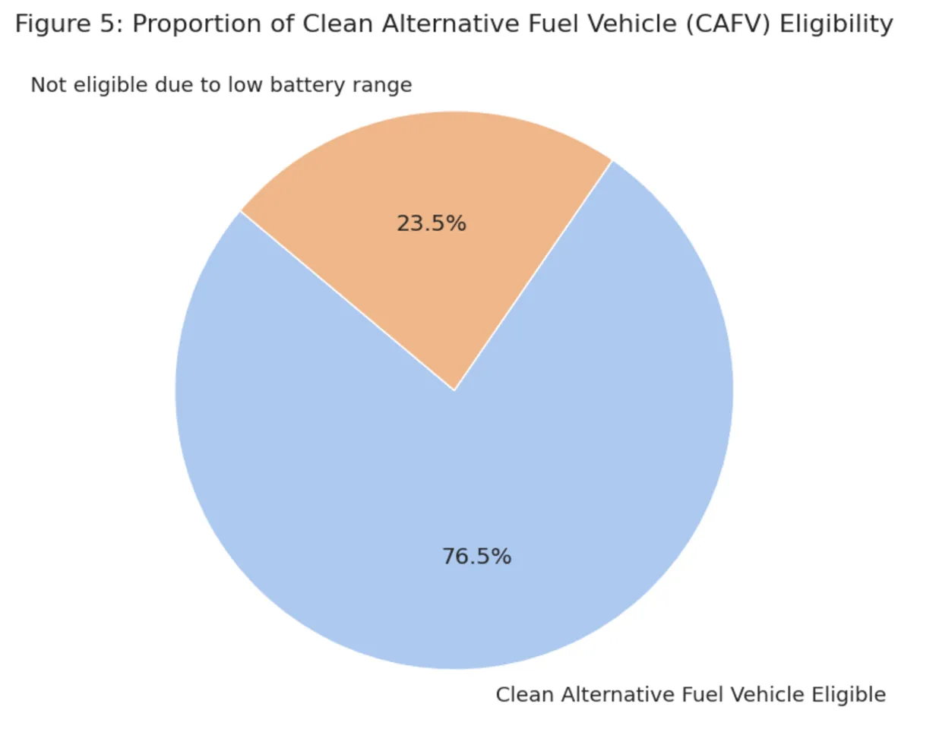
What Did We Find?
Manufacturer Analysis
CAFV Eligibility Distribution
Time Evolution

Slide 5
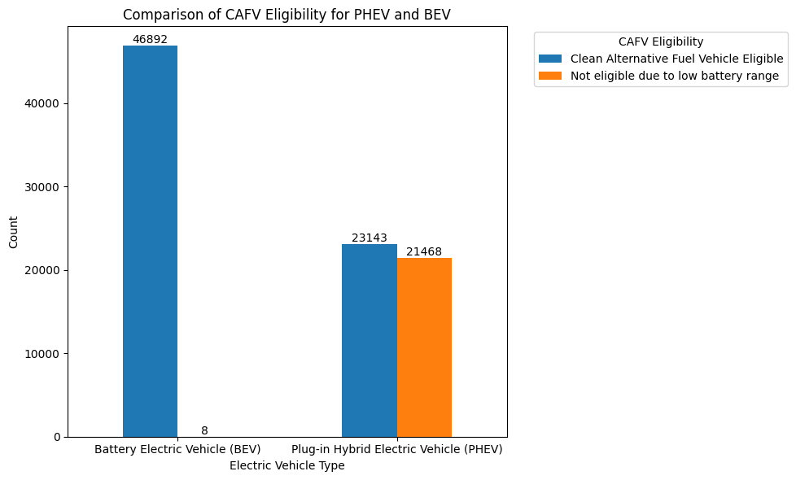
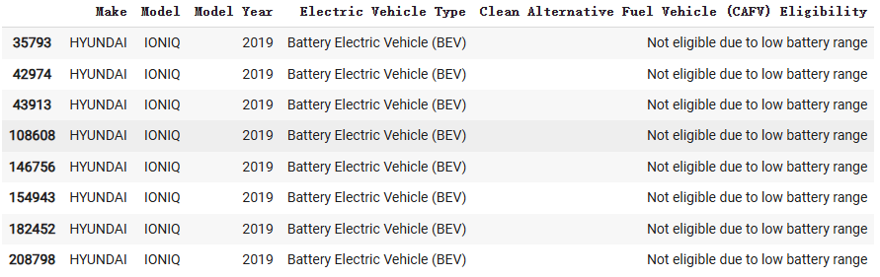
What Did We Find?
Are BEV vehicles perfect in eligible?

Slide 6
Implications of Our Result
Assessment of the current status of clean energy vehicle development：
The study quantifies the distribution of Clean Fuel Vehicle (CAFV) eligibility by year and make, clarifying the industry's progress in adopting clean energy standards.
By identifying the main reasons for non-compliance with CAFV standards (e.g., outdated technology and insufficient battery capacity), it provides policymakers and manufacturers with directions for improvement.
The study reveals the market-dominant relationships between brands, particularly Tesla's leadership in the clean-fuel vehicle market, as well as the market distribution characteristics of other brands.

Slide 7
Reference
Templates:
https://facilities.umd.edu/fm-staff-connect/tools-resources/communications/communications-tools-resources
Data set:
https://catalog.data.gov/dataset/electric-vehicle-population-data
Reference

Slide 8
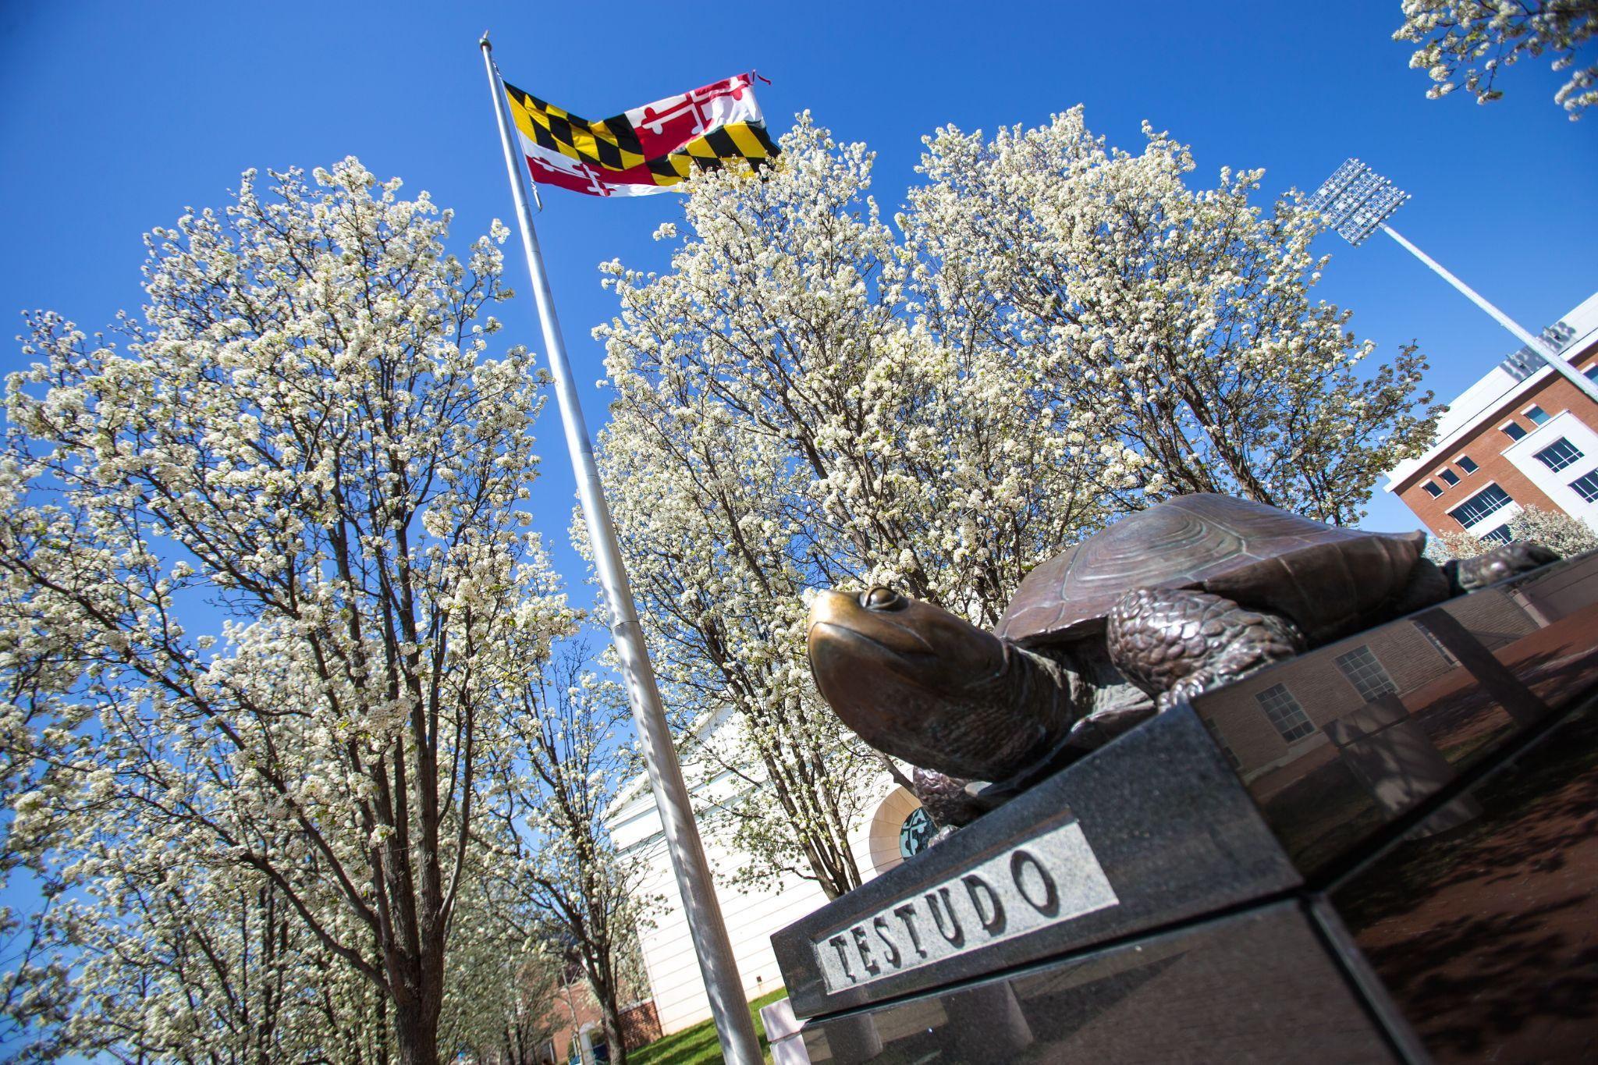
Question?

Slide 9
Thank You!

